Slide 1


Software Architecture and Design Patterns Filter Pattern
CIS 476/566
Tartil Chowdhury

Slide 2
Design Patterns in GoF
 |  |  | Purpose
 |  | Creational | Structural | Behavioral
Scope | Class | Factory method | Adapter (class) | Interpreter Template method
 | Object | Abstract factory Builder Prototype Singleton | Adapter (object) Bridge Composite Decorator Façade Flyweight Proxy Filter | Chain of responsibility Command Iterator Mediator Memento Observer State Strategy Visitor

Slide 3
What Are Structural Patterns?
Structural Patterns
Deal with the composition of classes or objects
Two categories
Object structural patterns
Describe ways to assemble objects (e.g., Decorator, Proxy, Filter)
Class structural patterns
Use inheritance to compose classes (e.g., Adapter)

Slide 4
Filter Pattern: Background/Intent
The “Filter” or “Criteria” pattern is a design pattern that enables developers to filter a set of objects using different criteria and chaining them in a decoupled way through logical operations.
This type of design pattern falls under structural patterns as this pattern combines multiple criteria to obtain a single criteria.

Slide 5
Filter Pattern: Motivation
Context
Often, an application contains many objects that can be manipulated, but certain actions are to only be performed on a subset that fit a particular criteria
Problem
Programmers need to filter these objects to manipulate those that meet a specified criteria
Solution
Filter/Criteria pattern provides a way to filter these objects

Slide 6
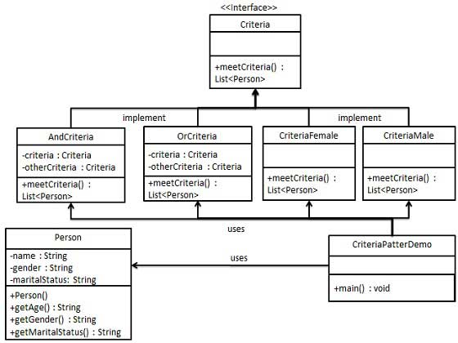
Structure/Example UML Diagram:

Slide 7
Basic Procedure
Create a class on which the criteria is to be applied.
Create an interface for “Criteria”.
Create concrete classes implementing the Criteria interface.
Use different Criteria and their combination to filter out objects.
Verify the output.

Slide 8
Step 1: Creating a class on which criteria is to be applied
class Vehicle { private String make; private String model; private String bodyStyle; private String driveType; private String fuelType; private int cylinders; public Vehicle(String make, String model, String bodyStyle, String driveType, String fuelType, int cylinders) { this.make = make; this.model = model; this.bodyStyle = bodyStyle; this.driveType = driveType; this.fuelType = fuelType; this.cylinders = cylinders; } public String getMake() { return make; } public String getModel() { return model; } public String getBodyStyle() { return bodyStyle; } public String getDriveType() { return driveType; } public String getFuelType() { return fuelType; } public int getCylinders() { return cylinders; } }

Slide 9
Step 2: Creating an interface for “Criteria”
interface Criteria { public List<Vehicle> meetCriteria(List<Vehicle> vehicles); }

Slide 10
Step 3: Creating concrete classes implementing the Criteria interface
class CriteriaSedan implements Criteria { @Override public List<Vehicle> meetCriteria(List<Vehicle> vehicles) { List<Vehicle> sedanVehicles = new ArrayList<Vehicle>(); for (Vehicle vehicle : vehicles) { if(vehicle.getBodyStyle().equalsIgnoreCase("SEDAN")){ sedanVehicles.add(vehicle); } } return sedanVehicles; } }

Slide 11
Step 3 (Continued): Creating concrete classes implementing and/or logic for Criteria interface
class AndCriteria implements Criteria { private Criteria criteria; private Criteria otherCriteria; public AndCriteria(Criteria criteria, Criteria otherCriteria) { this.criteria = criteria; this.otherCriteria = otherCriteria; } @Override public List<Vehicle> meetCriteria(List<Vehicle> vehicles) { List<Vehicle> firstCriteriaVehicles = criteria.meetCriteria(vehicles); return otherCriteria.meetCriteria(firstCriteriaVehicles); } } class OrCriteria implements Criteria { private Criteria criteria; private Criteria otherCriteria; public OrCriteria(Criteria criteria, Criteria otherCriteria) { this.criteria = criteria; this.otherCriteria = otherCriteria; } @Override public List<Vehicle> meetCriteria(List<Vehicle> vehicles) { List<Vehicle> firstCriteriaItems = criteria.meetCriteria(vehicles); List<Vehicle> otherCriteriaItems = otherCriteria.meetCriteria(vehicles); for (Vehicle vehicle : otherCriteriaItems) { if(!firstCriteriaItems.contains(vehicle)){ firstCriteriaItems.add(vehicle); } } return firstCriteriaItems; } }

Slide 12
Step 4: Using different Criteria and their combinations to filter out objects
public class Main { public static void main(String[] args) { List<Vehicle> vehicles = new ArrayList<Vehicle>(); vehicles.add(new Vehicle("Ford","Mustang", "Coupe","RWD", "gasoline",8)); vehicles.add(new Vehicle("Ford","F150", "Truck","4WD", "gasoline",8)); vehicles.add(new Vehicle("Ford","Ranger", "Truck","4WD", "gasoline",4)); vehicles.add(new Vehicle("Ford","Explorer", "SUV","4WD", "gasoline",6)); vehicles.add(new Vehicle("Toyota","Camry", "Sedan","FWD", "gasoline",4)); vehicles.add(new Vehicle("Toyota","4Runner", "SUV","4WD", "gasoline",6)); vehicles.add(new Vehicle("Toyota","Rav4", "SUV","4WD", "gasoline",4)); Criteria sedan = new CriteriaSedan(); Criteria fourWheelDrive = new CriteriaFourWheelDrive(); Criteria fourCyl = new CriteriaFourCyl(); Criteria toyota = new CriteriaToyota(); Criteria ford = new CriteriaFord(); Criteria fordAndFourWheelDrive = new AndCriteria(ford, fourWheelDrive); Criteria toyotaOrFord = new OrCriteria(toyota, ford); Criteria toyotaAndFourCyl = new AndCriteria(toyota, fourCyl); System.out.println("\nSedans: "); printVehicles(sedan.meetCriteria(vehicles)); System.out.println("\nFour Wheel Drive Fords: "); printVehicles(fordAndFourWheelDrive.meetCriteria(vehicles)); System.out.println("\nToyota Or Ford: "); printVehicles(toyotaOrFord.meetCriteria(vehicles)); System.out.println("\nFour Cylinder Toyotas: "); printVehicles(toyotaAndFourCyl.meetCriteria(vehicles)); } public static void printVehicles(List<Vehicle> vehicles){ for (Vehicle vehicle : vehicles) { System.out.println(vehicle.getMake() + " " + vehicle.getModel() + ", Body Style: " + vehicle.getBodyStyle() + ", Drive: " + vehicle.getDriveType() + ", Fuel: " + vehicle.getFuelType() + ", Cylinders: " + vehicle.getCylinders()); } } }

Slide 13
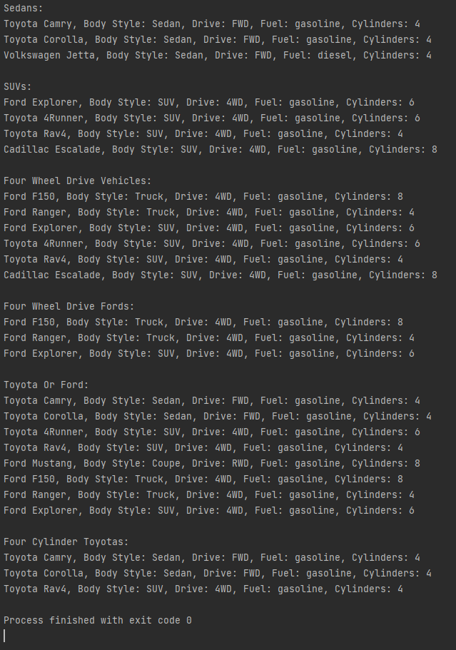
Step 5: Verifying Output

Slide 14
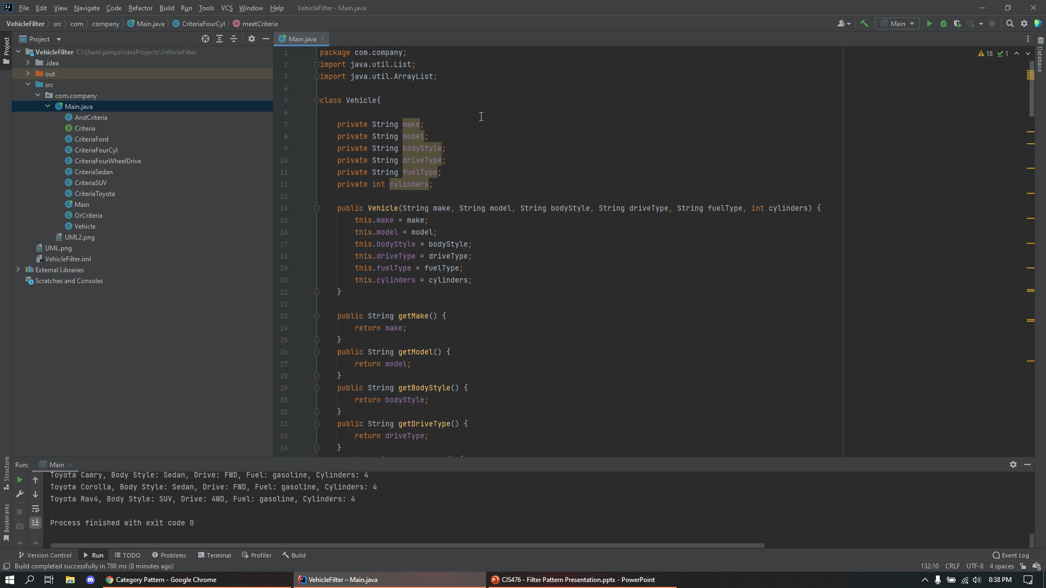

Slide 15
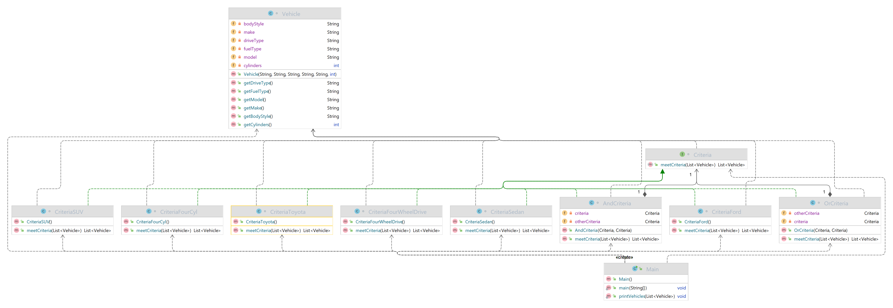
Implementation UML Diagram:

Slide 16
References:
http://wiki.c2.com/?CategoryPattern
https://www.tutorialspoint.com/design_pattern/filter_pattern.htm
https://www.geeksforgeeks.org/filter-pattern-in-java/
https://dzone.com/articles/using-filter-design-pattern-in-java

